Slide 1

Impact of Device Performance on Mobile Internet QoE
Mallesh Dasari, Santiago Vargas, Arani Bhattacharya,
Aruna Balasubramanian, Samir R. Das, Michael Ferdman
Stony Brook University
Notes:
Good morning all. My name is Mallesh from Stony Brook. This work is in collaboration with Santiago, Arani, Aruna, Samir and Michael all from Stony Brook. The goal of this work is to understand the impact of device-side bottlenecks on QoE of internet applications.

Slide 2
A large fraction of developing regions use low-end smartphones (about 62%-68%)^{[1]}
A large diversity in mobile device hardware
Intex Amaze
Google Pixel2
Device impact on QoE is not clear
(Unlike Network)
Low-end
High-end
Cost | $60 | $700
CPU Clock | 300MHz – 1.2GHz | 700MHz – 2.4GHz
Memory | 1GB | 4GB
#Cores | 4 | 8
[1] Unity. http://hwstats.unity3d.com/mobile/
Notes:
The major motivation behind this work is that a large number of users from developing regions use inexpensive smartphones. And these inexpensive phones have very low-end hardware for example if you see Intex amaze, a popular phone in Indai, has way different configuration than a high-end phone pixel2. And not just this, there is a large hardware diversity among these mobile devices. More importantly, most of the current work has focused on the impact of network bottlenecks on QoE and it is not clear what the role of device on these mobile Internet applications.

Slide 3
Are Internet applications affected by low-end hardware?
Application Category
QoE Metrics
Web Browsing
PLT
Video Streaming
Startup Latency,
Stall Ratio
Call Setup Delay,
Framerate
Video Telephony
Notes:
So in this regard, we ask the question how much of the mobile Internet applications are affected by low-end device hardware. For this, we choose three popular applications--- web browsing, video streaming and telephony. Where we use google chrome for browsing, youtube for streaming and skype for telephony. We use the respective state-of-the-art QoE metrics, for example, page load time for Web, startup latency, stall ratio for streaming, call setup delay and framerate for video calls.

Slide 4
Device Models and Hardware Configuration
Phone Model
Cost ($)
Clock (Min-Max)
Memory (GB)
#Cores
Intex Amaze
60
300-1300
1
4
Gionee F103 M
150
300-1300
2
4
Google Nexus4
200
384-1512
2
4
Samsung S2 Tab
450
400-1300
3
8
Google Pixel-C Tab
600
204-1912
3
4
Google Pixel2
700
300-2457
4
8
Samsung S6 Edge
880
400-2100
3
8
Notes:
And we experiment these applications on 7 different devices with diverse hardware configuration varies from 60 bucks to almost 1000 bucks actually recently. The corresponding hardware parameters for example, CPU clock frequencies are from 300MHz to 2.5GHz, and similarly a significant difference in other parameters.

Slide 5
Device Parameters
CPU clock frequency
# CPU cores
Memory
Others (GPU, CPU governors, etc.)
Constant network with 75Mbps link, zero loss, 10ms latency
Notes:
With that we choose crucial device parameters like clock frequency, memory, number of cores, governors and GPU etc. For now, I will show key subset of these results. Aah, btw the we host a constant network LAN with link parameters of 75 mbps and zero loss with 10ms latency.

Slide 6



Key result: Web browsing is the most affected by low-end hardware
Web browsing
Video streaming
Video telephony
QoE Degradation
$
Device Cost
$$$
Notes:
Now, let’s see the performance of these applications across the devices that I mentioned. Out of all the apps, we find that browsing is really doing bad and has very non-linear effect with the device configuration. Where as the streaming has zero effect on QoE while the telephony has a linear effect. Now lets see why the this discrepancy among these applications and what the critical bottleneck is.

Slide 7
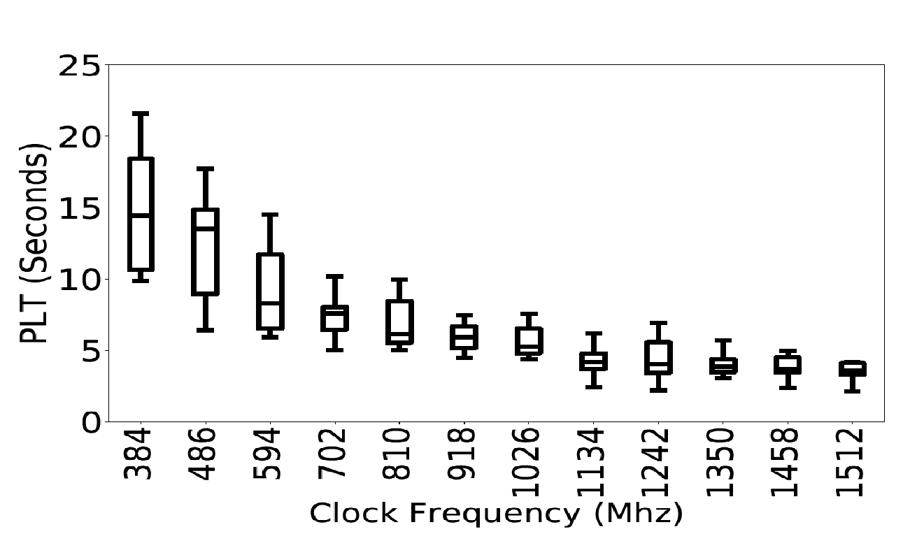
Web performance is highly affected by CPU clock frequency
More than 10 second increase in PLT from 384MHz to 1.5GHz
(Nexus4)
Increasing the number of CPU cores does not improve QoE
Notes:
Interestingly, among the three apps, only browsing is affected by CPU clock frequency and is the only parameter that is affecting. So, as you see decreasing the clock from 1500 MHz to 300MHz, there is a 10 second increase. While this is an intuitive result that lower clock gives lower performance, this is not the case with other apps. Apart from clock, the browsing does not improve even if we increase the number of cores. This is because the the multi-cores are not being used effectively.

Slide 8
Breaking the effect of hardware on PLT (compute and network)
Compute: HTML parsing, scripting, painting and Layout.
Network: Downloading objects such as scripts, images etc.
Packet processing delay is increased from 2ms to 20ms from high clock to low clock
Second-order effect of network, compute effect,
and the effect of dependencies
Notes:
So, we breakdown the PLT into compute and network activities to further understand what part of the loading process is affected by clock frequency. Interestingly, not only the compute part of PLT, the network activities such as loading objects and scripts is taking very long irrespective of the constant network conditions. And the reason is that the network stack is becoming a bottleneck. For example, the packet processing delay is increased by almost 18ms from a high clock to low clock. This we call a second-order effect of network. So, there are multiple bottlenecks that are making the web worse.

Slide 9
Why is video streaming not as affected?
Hardware acceleration
(Even low-end phones have video accelerators)
Prefetch opportunity
(Masking second-order effect)
Using the multi-cores effectively for post processing of decoding
Video Telephony is still affected by second-order effect
Notes:
Whereas, the answer for the video streaming streaming is not being affected is because of several optimizations. The very crucial and that everyone kind of knows is the use of hardware accelerators for video decoding. The second-order effect of network is masked because it can prefetch the content. And last, it is using multi-cores for post processing of muxing and demuxing of audio and video. Recall, web browsing is significantly impacted by clock because it was neither using coprocessors nor multicores.
And, in case of telephony, we observed a linear effect because of the second-order effect of the network as there is no prefetch opportunity for the live streaming.

Slide 10
Can we use hardware accelerators for the Web?
Not as easy as video applications
No significant data parallelism like video processing
Which accelerator?
GPU, DSP, or a Web accelerator
Which part of the Web should be improved?
JavaScript is the most expensive in terms of compute
Websites (e.g. Sports sites) with more JavaScript have significant effect
Javascript can be offloaded to DSP
Notes:
So with these observations in mind, we ask that … can we have an accelerator for Web? Is it as easy as video applications? What kind of accelerator? Which code to offload? Etc. So, we manually analyzed the code patterns and function level code profiling. And found that regular expression evaluation is taking significant time while loading and can be offloaded.

Slide 11
DSP Offloading Results
18% improvement in PLT
Side result: 4x reduction in energy
Notes:
We observe an improvement of a median 18% PLT. While this a modest improvement compared to the improvements from the network optimizations, we consider this as a new direction for browsers to offload the computation to coprocessors. Plus, the side benefit is the DSP consumes very low power and we find 4 times reduction in energy consumption.

Slide 12
Conclusion
Mobile browsing is more vulnerable to low-end hardware compared to video applications
Mobile network stack overheads are very high on low-end devices
Mobile Web browsing computation can be offloaded to coprocessors
Thank You
Notes:
To conclude, I have been studying the QoE of different mobile internet applications across diverse network and device conditions. We find that the architecture of these applications are very different from one another and are impacted by network and device very differently. We made an initial effort to improve the QoE of these applications both from network and device perspective. Please let me know if you any questions or comments. Thank you.

